Slide 1
Design and Implementation of Cache Memory using Verilog HDL
Akshay Srikrishnan
Manipal Institute of Technology, Bengaluru
Tool: Xilinx Vivado | Language:Verilog HDL | May 2026

Slide 2
Memory Hierarchy
Registers
Fastest memory in processor
Built using flip-flops.
Very small storage capacity
• Used for immediate CPU operations
L1 Cache
• L1 and L2 caches are high-speed memory units placed between CPU and main memory
• Both caches are built using SRAM technology for faster access time
• L1 cache is smaller and faster, while L2 cache is larger with slightly higher latency
• These caches store frequently accessed instructions and data to reduce CPU wait time
• Cache memory significantly improves overall system performance by reducing DRAM accesses
L2 Cache
Main memory
• Fastest memory in processor
• Built using flip-flops
• Very small storage capacity
• Used for immediate CPU operations
• Fastest memory in processor
• Built using flip-flops
• Very small storage capacity
• Used for immediate CPU operations
Storage

Slide 3
Cache Memory Architecture
CPU Address
Address Split
• Address Split → Tag + Index.
• SRAM stores cache data.
• Comparator performs
hit/miss detection.
• Cache Hit → Fast data access.
• Cache Miss → Fetch from RAM.
Cache Memory
Data SRAM
Tag SRAM
Valid Bit
Comparator
Hit
Miss
Cache Hit
Hit/Miss
Cache Miss
Return Data
Fetch from RAM

Slide 4
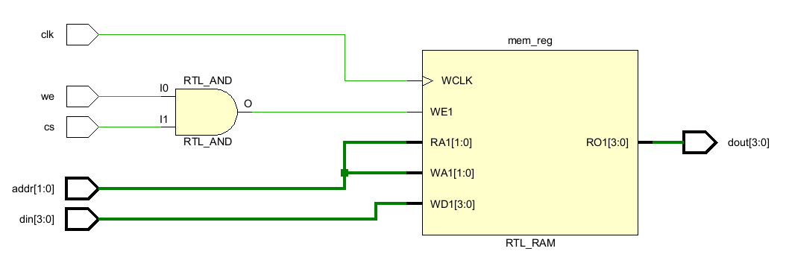
Data SRAM
• 4×4 SRAM contains 4 memory locations
• Each location stores 4-bit data
• Total storage capacity = 16 bits
• Address lines select one memory row
• SRAM performs fast read/write operations
• Used as Data SRAM in cache memory
Fig 1. Design of Data SRAM

Slide 5
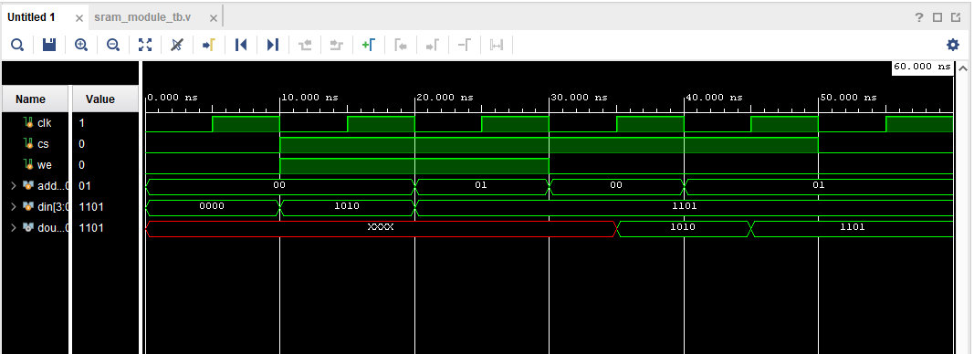
Simulation of 4X4 SRAM ( Data SRAM)
a.
b.
Addr=00
din-1010
we=1 Write operation: Data 1010 stored into mem location 00
Addr=01
din-1101
we=1 Write operation: Data 1101 stored into mem location 01
Read operation:
a) Stored data retrieved from address 00.
b) Stored data retrieved from address 01
Initial Unknown state(Uninitialized SRAM Contents)

Slide 6
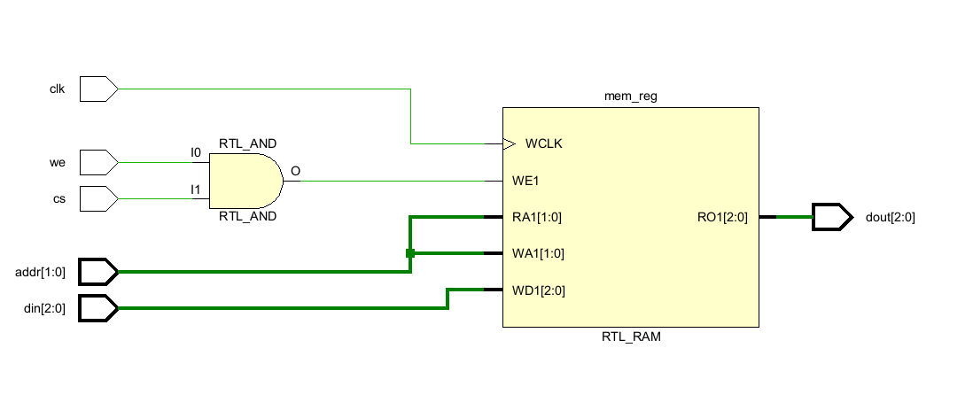
Tag SRAM
• Stores cache tag information.
• Contains 4 memory locations.
• Each location stores 3-bit tag.
• Used for cache hit detection.
• Tag compared with CPU address tag.
• Works together with comparator logic.
Fig 1. Design of Tag SRAM

Slide 7
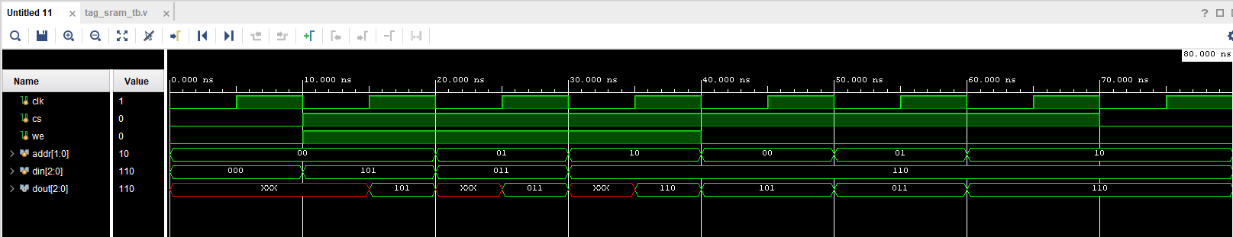
Simulation of 4X3 SRAM (Tag SRAM)
WRITE
Initial unknown tag values before write operation.
READ
Stored Tag 101 retrieved for comparison.
WE = 1 → Tag write operation.
WE = 0 → Tag read operation.
READ
Tag value 110 written into cache line 10.
Tag successfully read for hit/miss detection.
WRITE
Tag value 011 written into cache line 01.
READ
We:0 Stored tag 110 retrieved for hit/miss detection.
WRITE
Tag value 101 written into cache line 00.

Slide 8
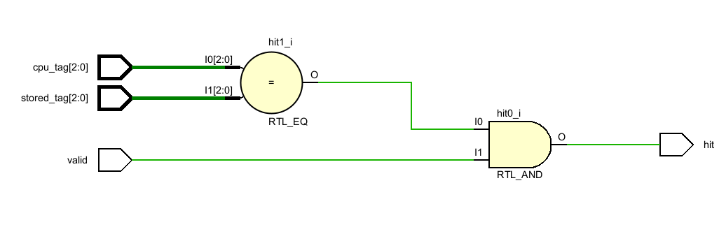
Comparator/Hit Logic
• Compares CPU tag with stored tag.
• Valid bit checked before comparison.
• Matching tags generate cache hit.
• Mismatched tags generate cache miss.
• Hit signal enables cache data output.
• Core block for cache decision making.
Fig 1. Design of Comparator/Hit Logic

Slide 9
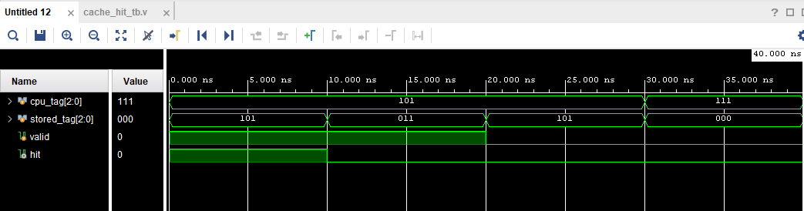
Simulation of Comparator for Hit or Miss
HIT:
Matching tag values with valid bit enabled generate cache hit.
Cache miss generated due to tag mismatch.
MISS:
Different tag values result in cache miss.
Comparator checks whether:
CPU Tag = Stored Tag
If tags match and valid bit = 1,
cache hit is generated.
Valid bit must be enabled for cache hit generation.
Comparator successfully detects matching cache line.

Slide 10
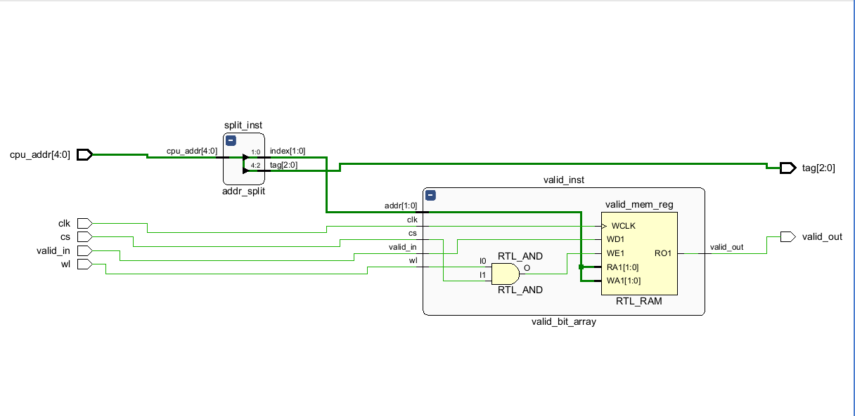
Valid Bit Array + Address Split Logic
• Address Split Logic divides the CPU address into tag bits and index bits
• Tag bits are used for cache comparison operations
• Index bits select the required cache memory line
• Valid Bit Array stores validity information for each cache line
• Valid bit = 1 indicates valid cache data is present
• Valid bit = 0 indicates cache line is empty or invalid
• Comparator checks both tag match and valid bit status
• Together, these modules enable accurate cache hit/miss detection
Fig 1. Valid Bit Array+Address Split Logic

Slide 11
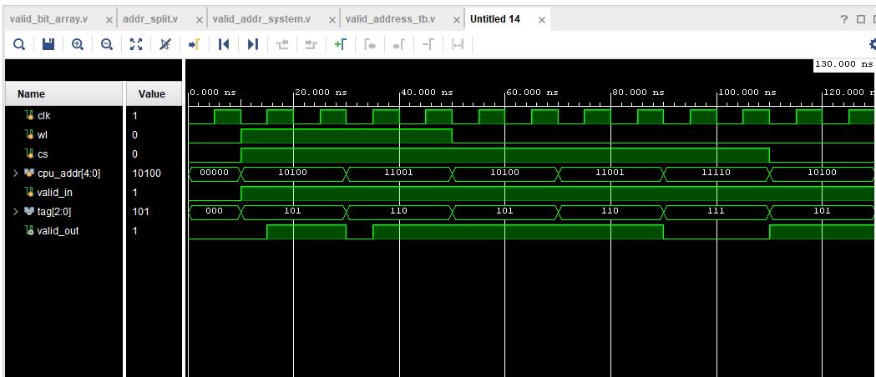
Simulation of Valid Bit array+Address split logic
WL = 1 → Valid bit write operation
WL = 0 → Valid bit read operation
CPU address split into:
a)TAG = 101
b)INDEX = 00
Address split logic extracts tag and index bits
Invalid cache line detected
(valid bit = 0)
Address split logic divides the CPU address into tag and index bits.
The valid bit array verifies whether the selected cache line contains usable cache data.
WL = 1
valid_in = 1
Valid bit written into selected cache line
valid_out = 1
Selected cache line contains valid data

Slide 12
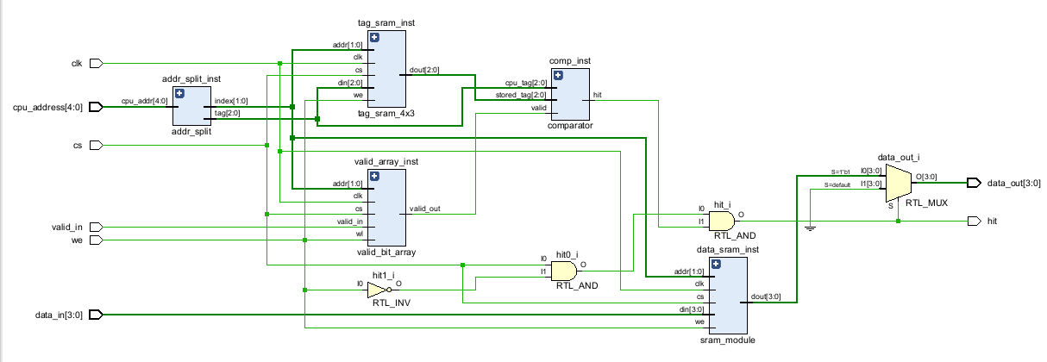
Cache Top Module
• Integrates all cache datapath modules.
• Connects SRAM, tag and valid arrays.
• Performs cache hit/miss detection.
• Controls cache read/write operations.
• Outputs final cache data to CPU.
• Represents complete cache datapath.
Cache Top Flow:
CPU Address
Address Split
Cache Mem Access
Comparator
H/M Logic
Cache Output

Slide 13
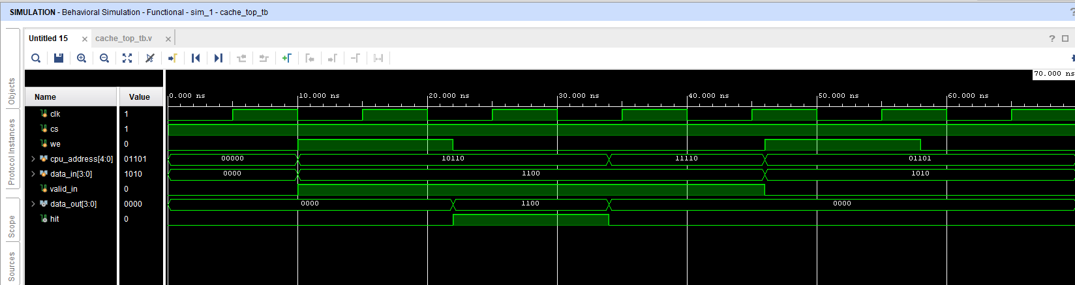
Simulation of Cache Top Module
Cache write operation:
Data 1100 stored into cache line selected by address 10110
Address split logic extracts:
TAG = 101
INDEX = 10
New cache line written into SRAM arrays
Cache miss:
Tag mismatch or invalid cache line detected
Cache hit detected:
Stored tag matches CPU tag and valid bit = 1. Cached data returned directly to CPU.
The cache_top module integrates address split logic, SRAM arrays, valid bit array, and comparator logic to perform complete cache hit/miss detection and data retrieval operations.

Slide 14
Final Cache System
• cache_top performs primary cache lookup operations
• Address split logic generates tag and index bits
• SRAM arrays store cache data, tags, and validity information
• Comparator logic determines cache hit or cache miss
• Cache controller FSM coordinates miss handling operations
• Dirty bit array tracks modified cache lines
• Write policy logic controls memory update behavior
• Block replacement logic selects cache line replacement during misses
• Main memory module supplies data during cache refill operations
• All modules operate together as a unified cache memory subsystem

Slide 15
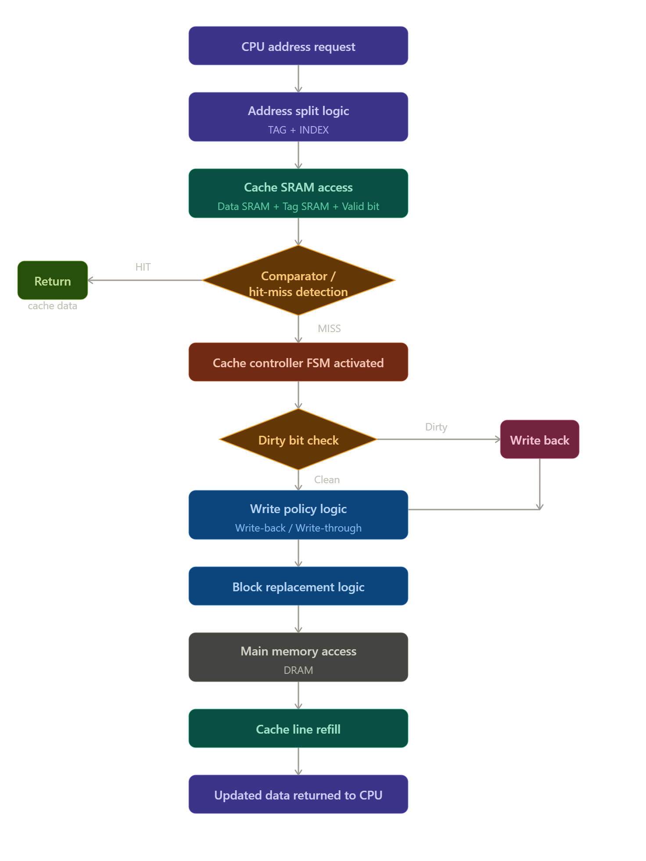
• CPU address is divided into TAG and INDEX bits.
• Data SRAM, Tag SRAM and Valid Bit Array are accessed simultaneously.
• Comparator checks tag matching and valid bit status.
• Matching tag and valid bit generate cache HIT.
• Cache HIT enables immediate SRAM data return to CPU.
• SRAM-based cache access significantly reduces memory latency.
• Cache MISS activates the cache controller FSM.
• Dirty bit logic checks whether modified cache data must be written back.
• Write policy logic controls memory synchronization behavior.
• Block replacement logic selects cache line replacement.
• Main memory (DRAM) supplies updated cache data.
• Refilled cache line is returned back to CPU.
Advantages of Cache Memory:
• High-speed SRAM based architecture
• Parallel cache lookup operation
• Reduced average memory access time
• Efficient hit/miss management
Integrated cache architecture combining high-speed SRAM datapath and memory management control logic.
If cache miss occurs, the control subsystem becomes active.

Slide 16
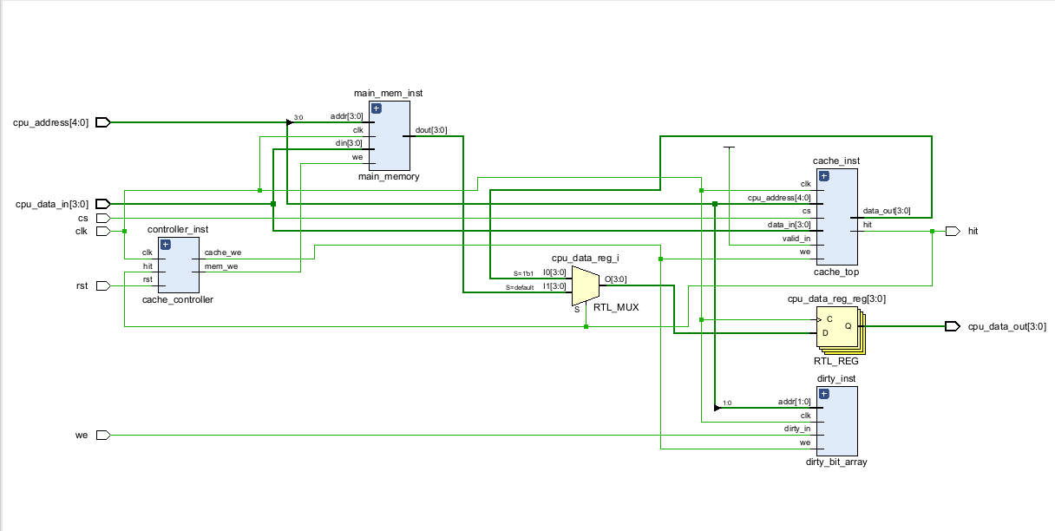
Schematic of Cache Memory

Slide 17

Simulation of Full Cache Memory:
Cache write operation:
Data 1100 written into cache line selected by address 10110.
Cache MISS:
Requested address not found in cache memory
Cache controller FSM activates miss handling operations
Refilled cache line successfully accessed.
Cache line refilled with updated memory data.
XXXX indicates temporary undefined output during cache initialization and transition operations.
Cached data immediately returned to CPU through SRAM datapath.
memory locations were not yet written with valid data
The integrated cache memory system performs address decoding, cache lookup, hit/miss detection, cache refill, and memory synchronization operations using SRAM datapath and cache control modules.

Slide 18
Conclusion:
• Successfully designed and simulated a complete direct-mapped cache memory architecture using Verilog HDL.
• Implemented SRAM-based cache storage, tag comparison, valid bit logic, and cache hit/miss detection.
• Integrated cache controller FSM, dirty bit logic, write policies, replacement logic, and main memory interface.
• Verified cache read/write operations, cache hit handling, and cache miss refill operations through behavioral simulation.
• Demonstrated practical implementation of memory hierarchy and cache management concepts.

